Slide 1
MySQL Database
TASK - https://sqlbolt.com/lesson - Interactive Exercises
-Sridhar Rajaram

Slide 2
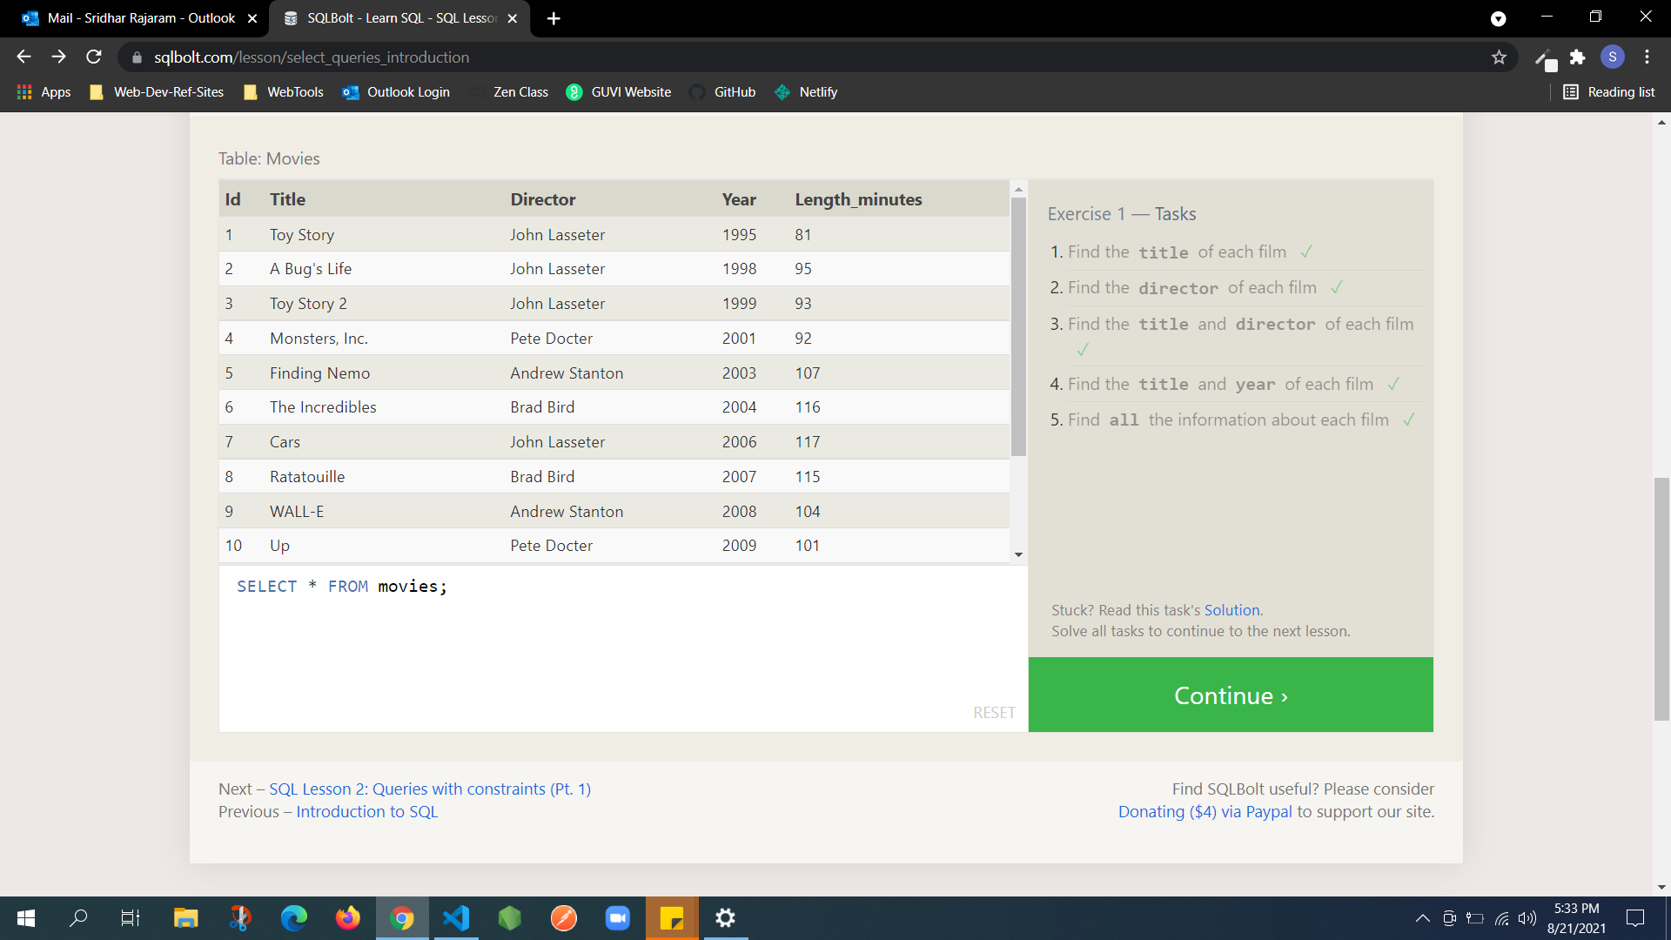
Notes:
SELECT title FROM movies;
SELECT director FROM movies;
SELECT title, director FROM movies;
SELECT title, year FROM movies;
SELECT * FROM movies;

Slide 3
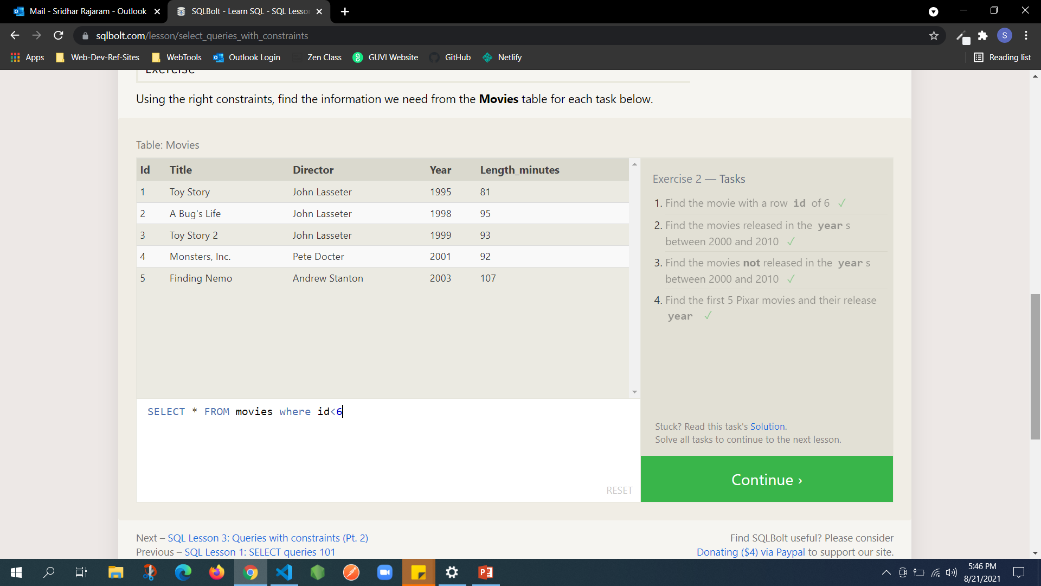
Notes:
SELECT * FROM movies WHERE id=6;
SELECT * FROM movies WHERE year BETWEEN 2000 AND 2010
SELECT * FROM movies where year NOT between 2000 and 2010
SELECT * FROM movies where id<6

Slide 4
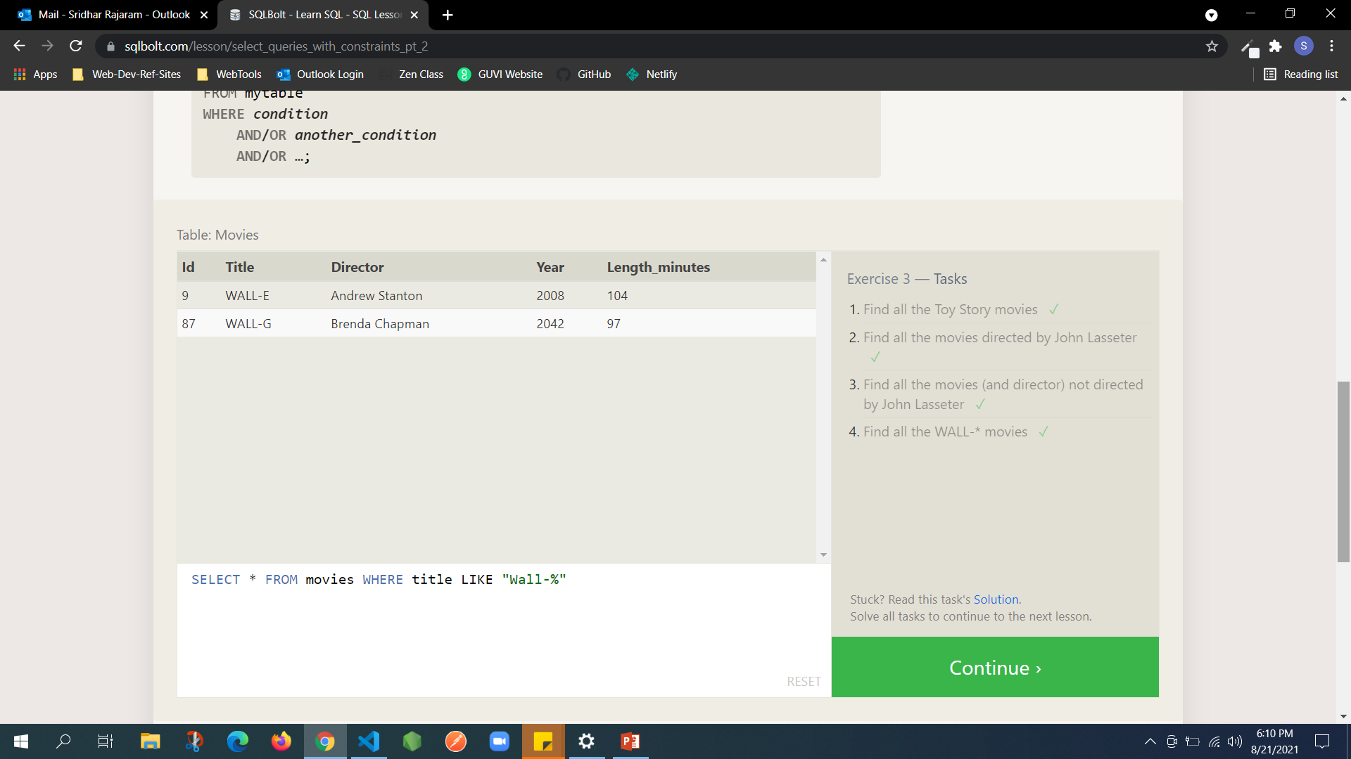
Notes:
SELECT * FROM movies WHERE title LIKE "toy Story%“
SELECT * FROM movies WHERE director LIKE "John Lasseter“
SELECT * FROM movies WHERE director NOT LIKE "John Lasseter“
SELECT * FROM movies WHERE title LIKE "Wall-%"

Slide 5
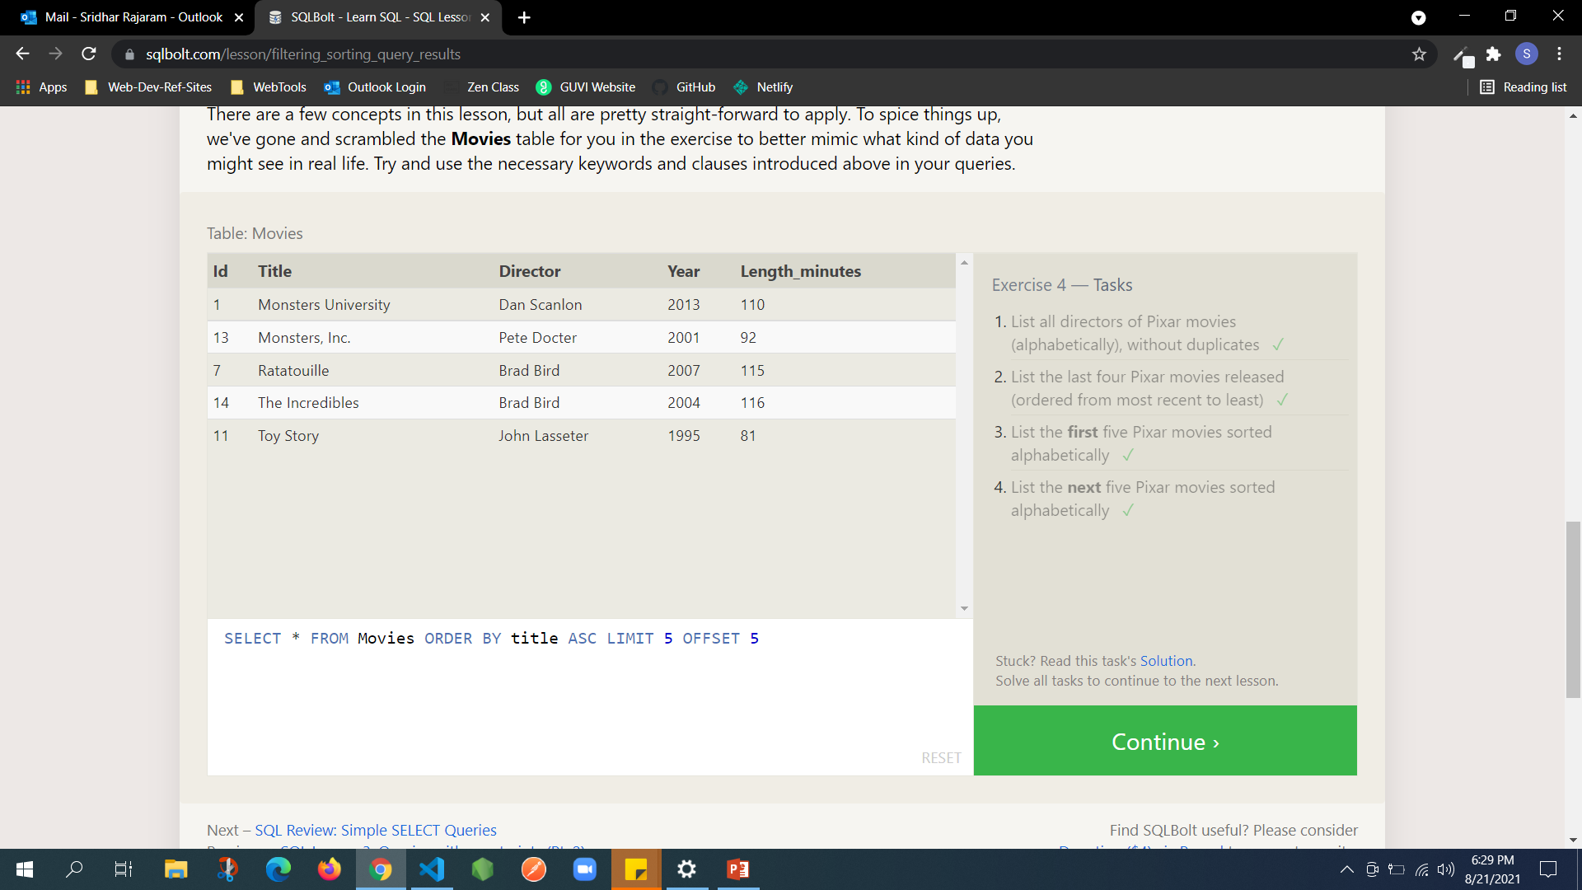
Notes:
SELECT DISTINCT director FROM Movies ORDER BY director ASC
SELECT * FROM Movies ORDER BY Year DESC LIMIT 4
SELECT * FROM Movies ORDER BY title ASC LIMIT 5
SELECT * FROM Movies ORDER BY title ASC LIMIT 5 OFFSET 5

Slide 6
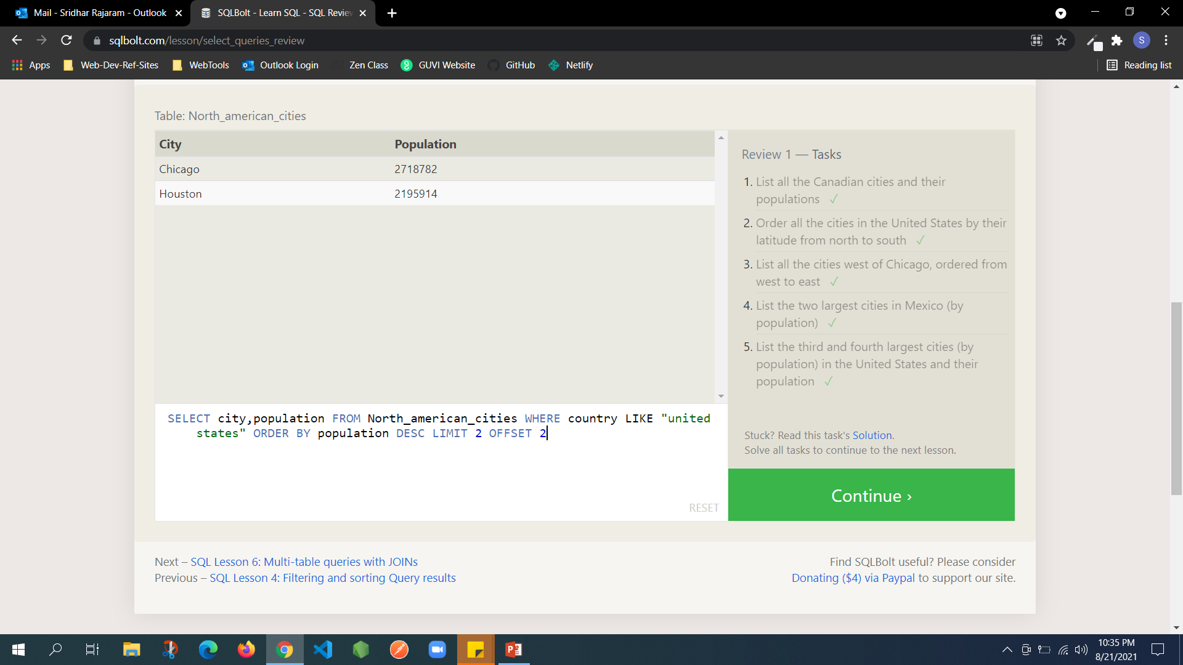
Notes:
SELECT * FROM north_american_cities WHERE country ="Canada“
SELECT * FROM north_american_cities WHERE country LIKE "united states" ORDER BY Latitude DESC
SELECT city FROM North_american_cities where longitude < (SELECT Longitude FROM north_american_cities WHERE city LIKE "chicago") ORDER BY Longitude ASC
SELECT city FROM North_american_cities WHERE country LIKE "Mexico" ORDER BY population DESC LIMIT 2
SELECT city,population FROM North_american_cities WHERE country LIKE "united states" ORDER BY population DESC LIMIT 2 OFFSET 2

Slide 7
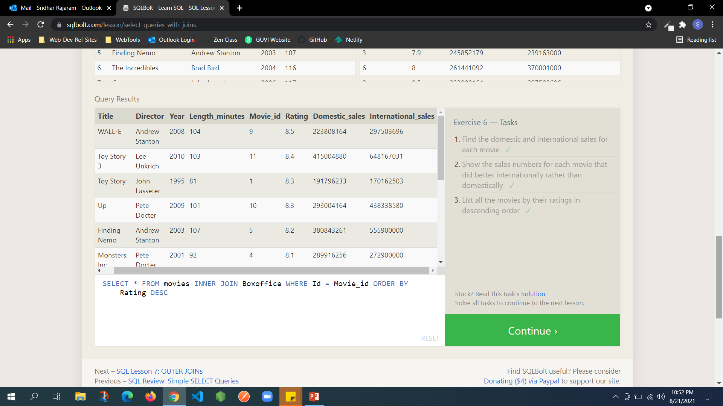
Notes:
SELECT * FROM movies INNER JOIN Boxoffice WHERE Id = Movie_id
SELECT * FROM movies INNER JOIN Boxoffice WHERE Id = Movie_id AND international_sales > Domestic_sales
SELECT * FROM movies INNER JOIN Boxoffice WHERE Id = Movie_id ORDER BY Rating DESC

Slide 8
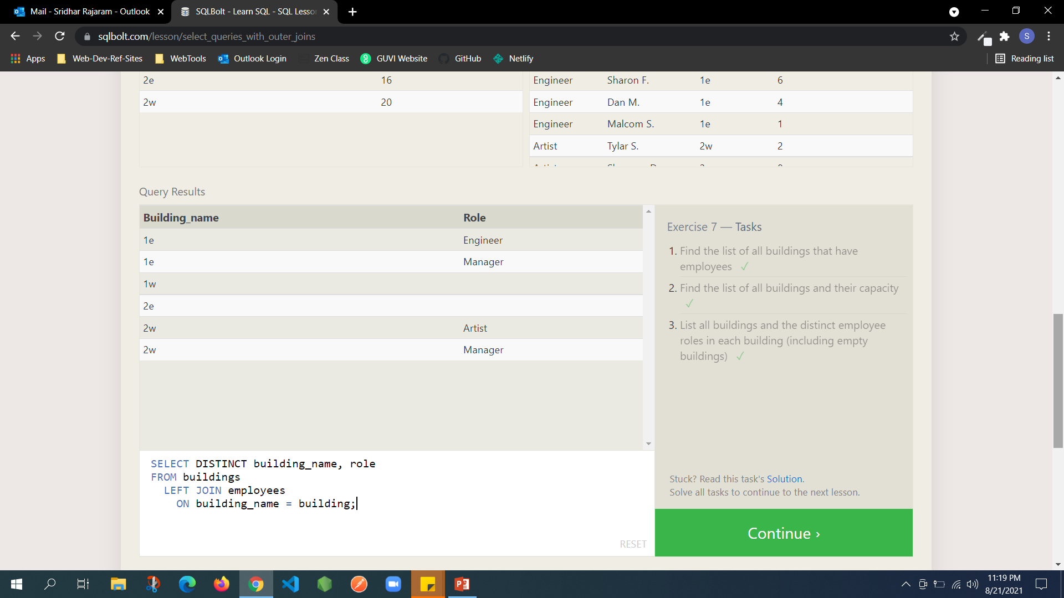
Notes:
SELECT DISTINCT building FROM employees;
SELECT * FROM Buildings
SELECT DISTINCT building_name, role FROM buildings LEFT JOIN employees ON building_name = building;

Slide 9

Notes:
SELECT DISTINCT name,Role FROM employees LEFT JOIN Buildings WHERE Building IS NULL
SELECT DISTINCT building_nameFROM buildings LEFT JOIN employees ON building_name = buildingWHERE role IS NULL;

Slide 10

Notes:
SELECT title, (domestic_sales + international_sales) / 1000000 AS Combined_Sales FROM movies LEFT JOIN boxoffice ON id = movie_id;
SELECT title,rating*10 as RatingPercentange FROM movies LEFT JOIN Boxoffice on id=movie_id
SELECT title FROM Movies where Year%2 = 0

Slide 11
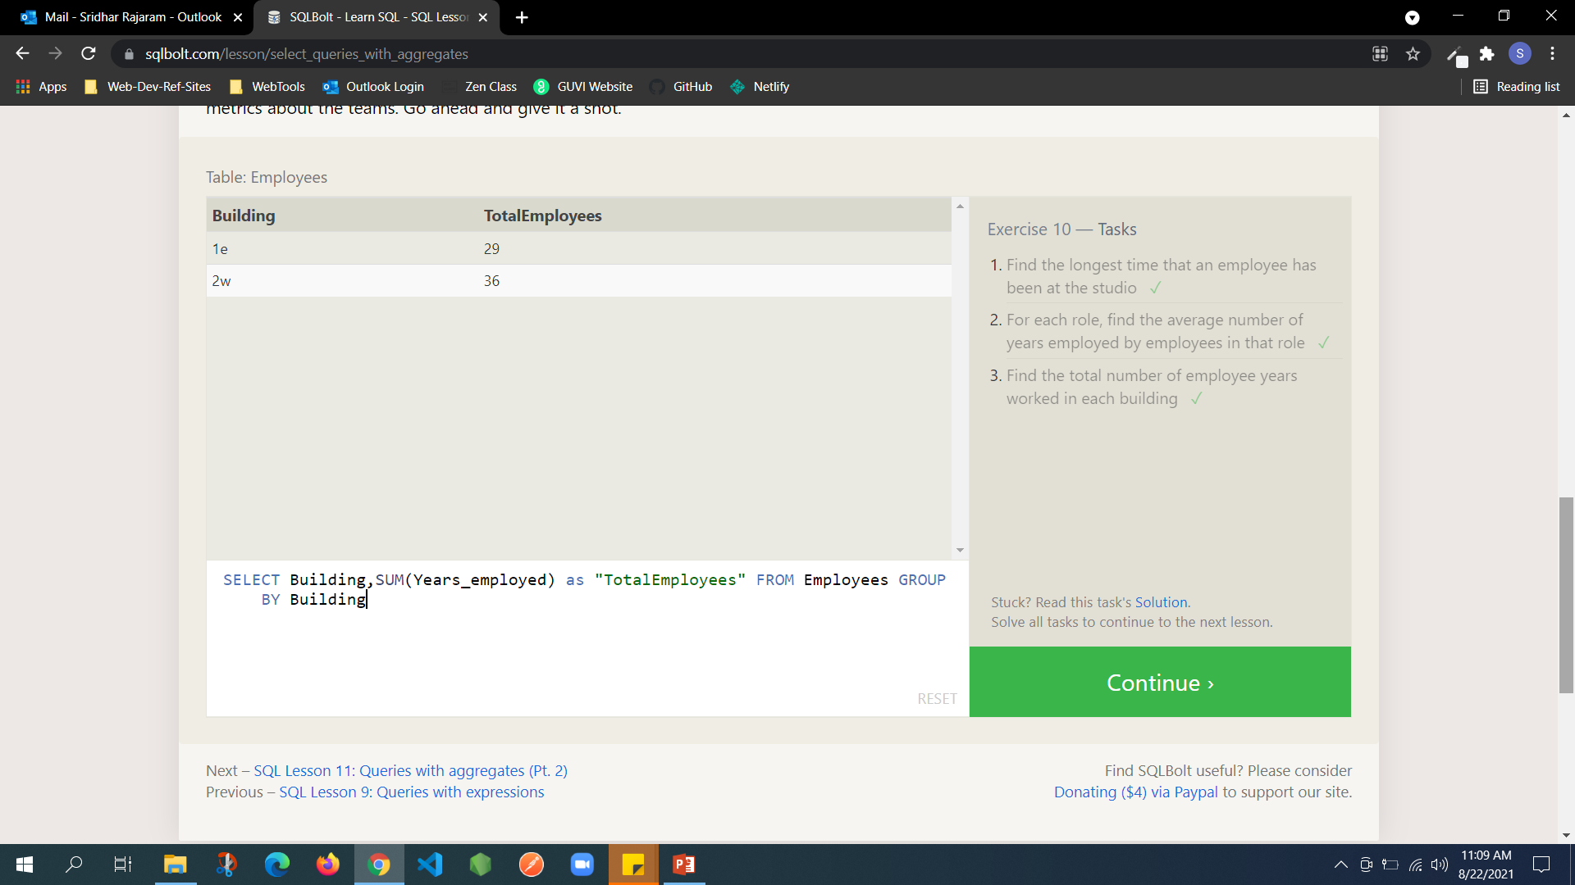
Notes:
SELECT MAX(Years_employed) FROM employees;
SELECT role, AVG(years_employed) as Average_years_employed FROM employees GROUP BY role;
SELECT Building,SUM(Years_employed) as "TotalEmployees" FROM Employees GROUP BY Building

Slide 12
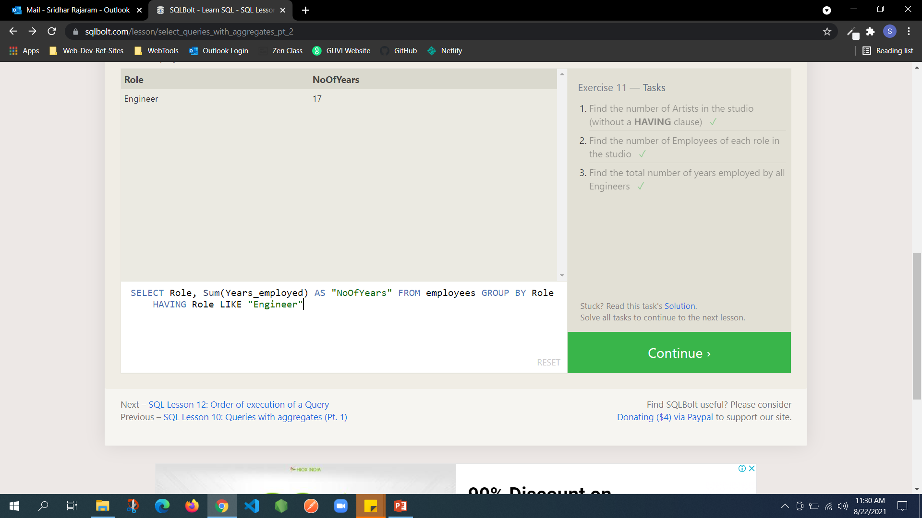
Notes:
SELECT Role,Count(Role) As "NoOfArtist" FROM employees where Role LIKE "Artist“
SELECT Role, count(Role) AS "NoOfEmployees" FROM employees GROUP BY Role
SELECT Role, Sum(Years_employed) AS "NoOfYears" FROM employees GROUP BY Role HAVING Role LIKE "Engineer"

Slide 13
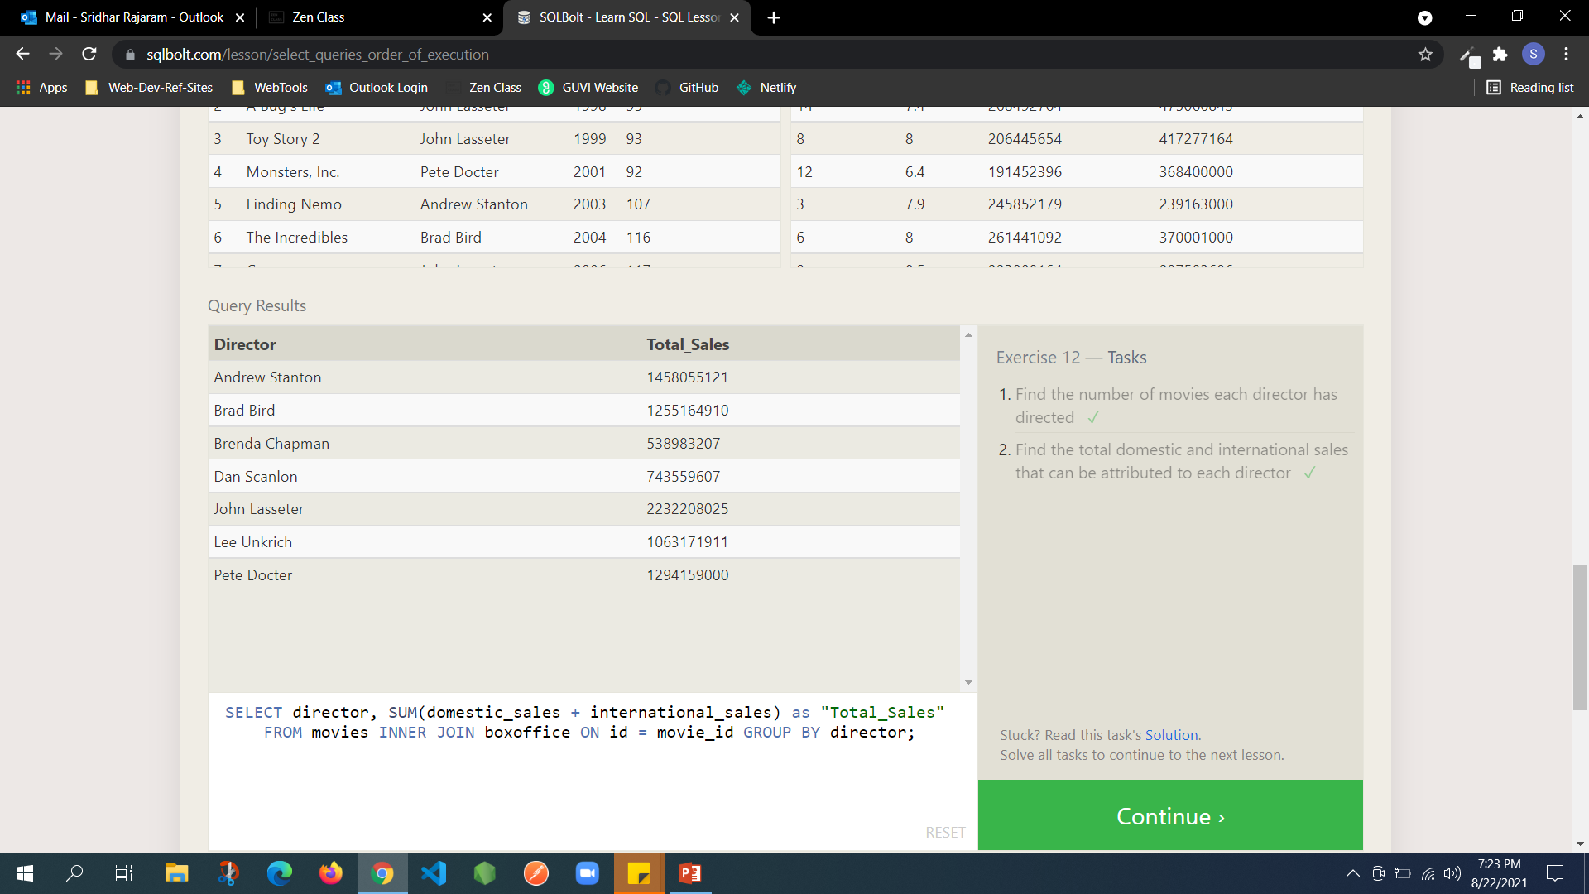
Notes:
SELECT title,director,count(title) AS "NoOfMovies" FROM movies GROUP BY director
SELECT director, SUM(domestic_sales + international_sales) as "Total_Sales" FROM movies INNER JOIN boxoffice ON id = movie_id GROUP BY director;

Slide 14
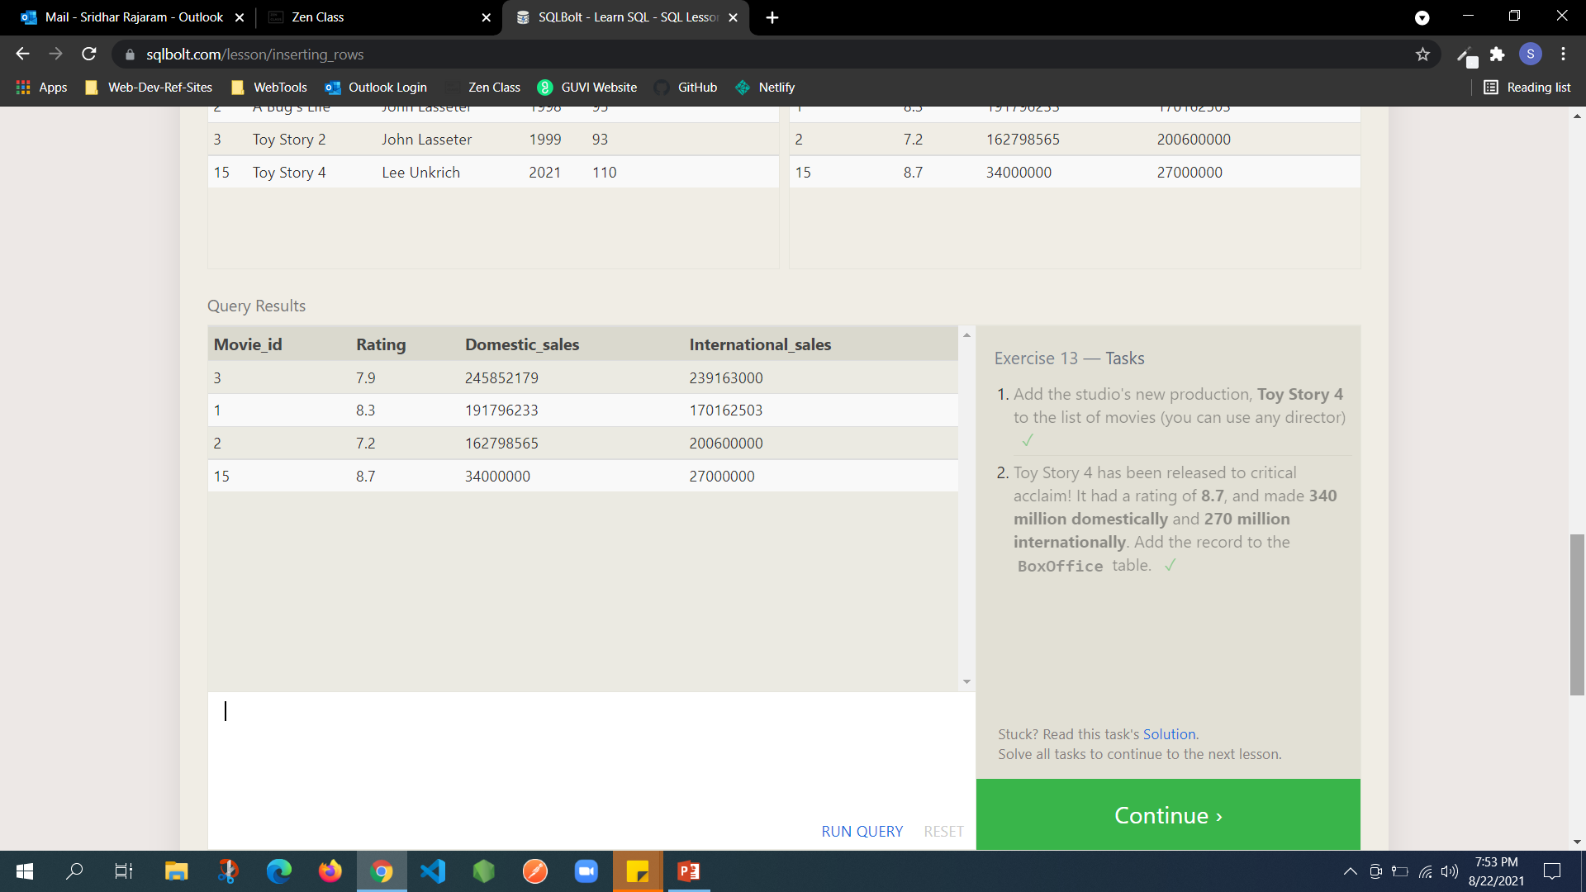
Notes:
INSERT INTO Movies (Id,Title,Director,Year,Length_minutes) VALUES (15,"Toy Story 4","Lee Unkrich", 2021, 110)
INSERT INTO Boxoffice (Movie_id,Rating,Domestic_sales,International_sales) VALUES (15,8.7,34000000,27000000)

Slide 15
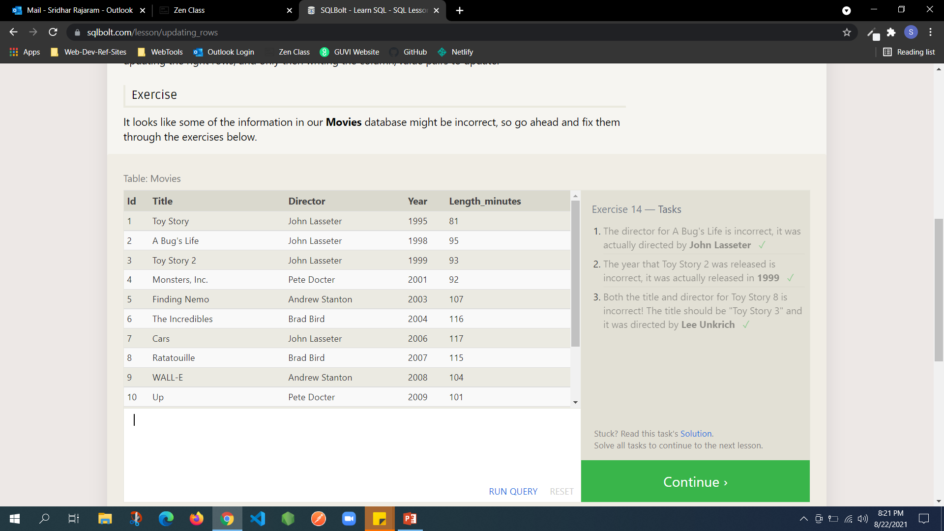
Notes:
UPDATE Movies SET Director = "John Lasseter" WHERE title LIKE "A Bug's life“
UPDATE Movies SET Year=1999 where Title LIKE "Toy Story 2“
UPDATE Movies SET title="Toy Story 3",Director="Lee Unkrich" WHERE Title LIKE "Toy Story 8"

Slide 16
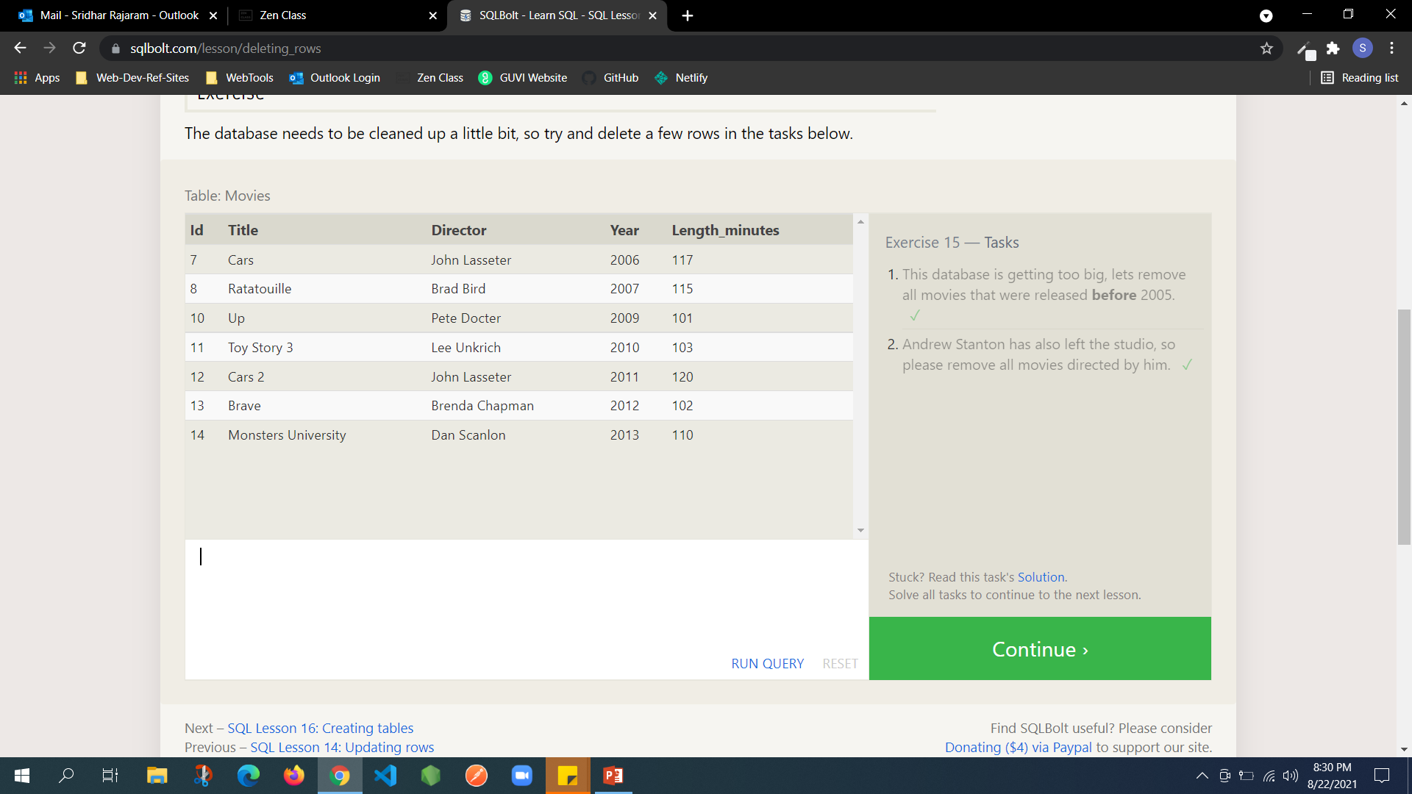
Notes:
DELETE FROM Movies where year<2005
DELETE FROM Movies WHERE Director LIKE "Andrew Stanton"

Slide 17
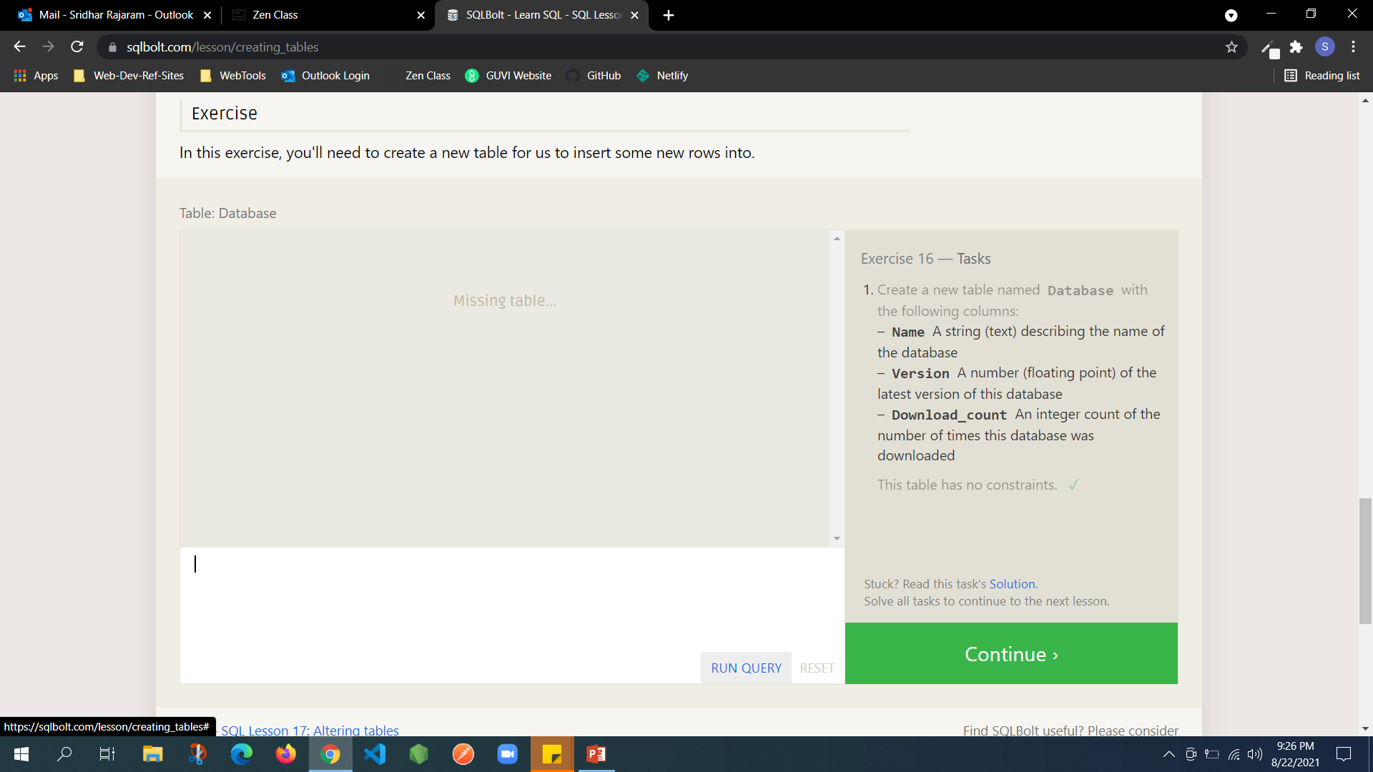
Notes:
1) CREATE TABLE Database(id INTEGER PRIMARY KEY, Name TEXT, Version FLOAT,Download_count INTEGER)

Slide 18
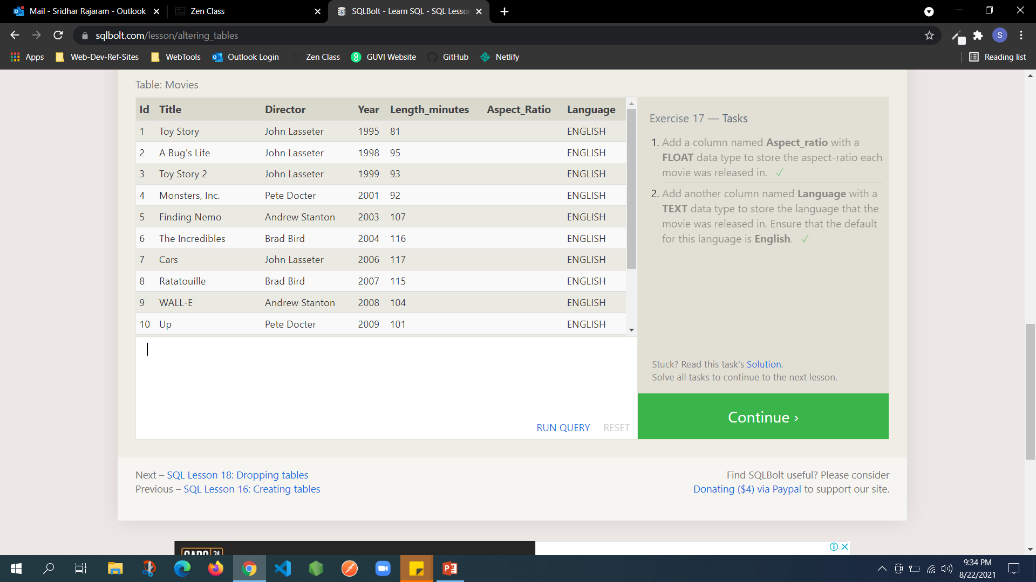
Notes:
ALTER TABLE Movies ADD "Aspect_Ratio" Float
ALTER TABLE Movies ADD "Language" INTEGER DEFAULT ENGLISH

Slide 19
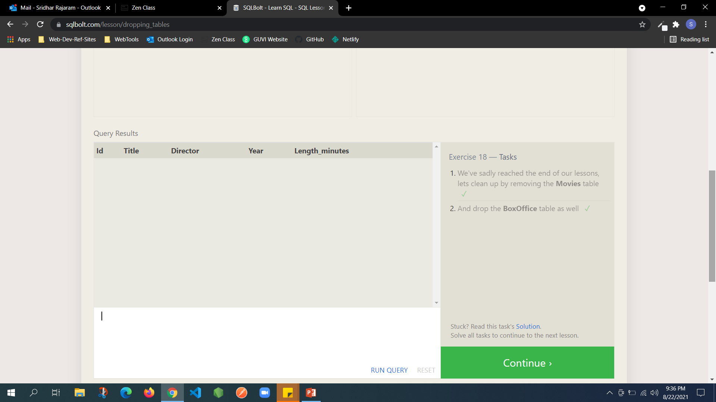
Notes:
DROP TABLE Movies
DROP TABLE Boxoffice

Slide 20


